Slide 1


Conmed XN Project
Le Yang, Weijing Wang, Xiaoyun Zhao, Neeti Panjwani,
Nikhilesh Rajeev, Ping Shi
ALY6080 Integrated Experiential Learn
Insuructor: Kristen Dronbnis
Northeastern University
03/25/2020

Slide 2

CONTENTS
Introduction
Inbound
Outbound
Asian Sales
Recall
Conclusion

Slide 3

Introduction
CONMED is a global medical technology company that specializes in the development and Sale of surgical and patient monitoring products and services.
They have over 20 locations worldwide such as New York, Florida, Australia, Canada and China
Shipping will be a big problem for a worldwide company.
We will analyze the inbound freight, outbound shipment and Asian’s Market.

Slide 4
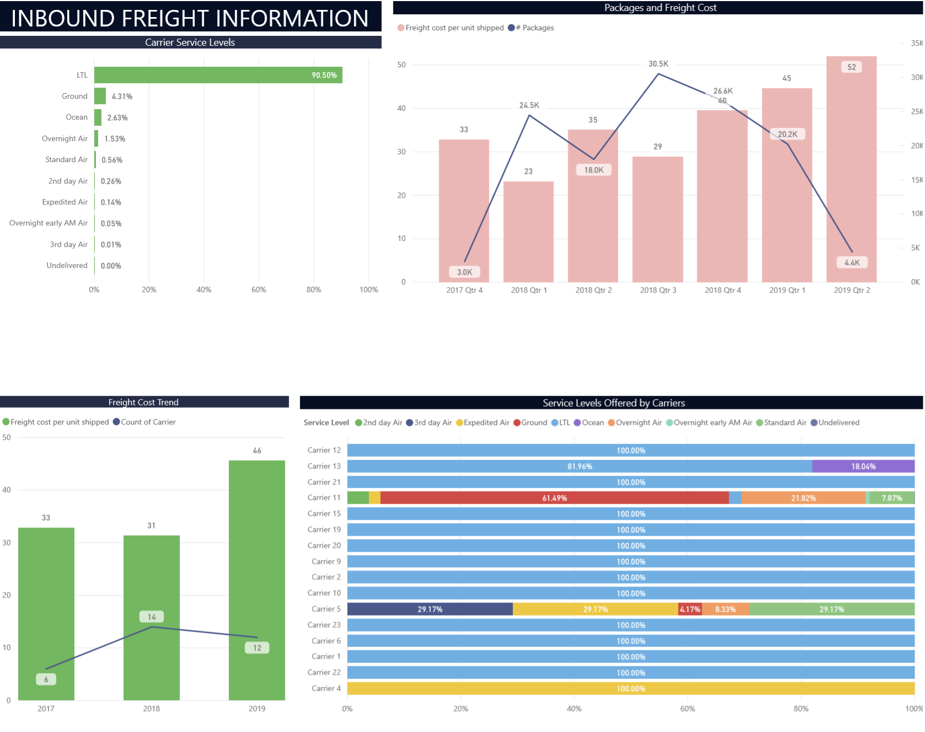
Inbound
In analyzing service level offered by carriers LTL is the service level offered by majority of the carriers. While some carriers like carrier 12, 15, 19 offer only LTL. Carriers like 11 and 5 offer multiple options. It is interesting to note that carrier 11 has been with Conmed for the last 3 years and has contributed to roughly 62% of total packages shipped by ground. On the other hand expedited air is an option provided by carrier 4, 5 and 11 only

Slide 5
Inbound
It is interesting to know that freight cost has been highest in 2019 with a steep increase of packages in the first quarter(20.2k) to a steep drop in packages in quarter 2(4.4k).
LTL has contributed to significant increase in freight cost. In contrast in 2017 ocean contributed to majority of freight cost.

Slide 6
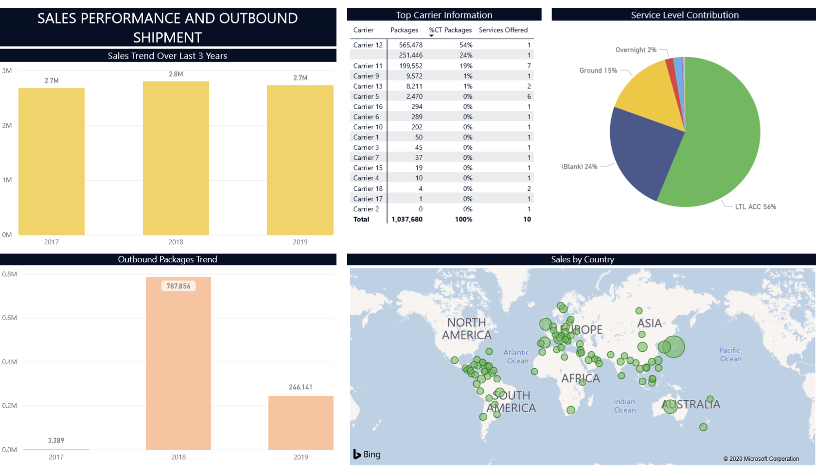
Outbound
2018 has been the best year for Conmed in last 3 years.
2018 has max outbound packages and min inbound packages as a result.
2018 has least freight cost out of 3 years.
We can also see that 2018 has been the year of maximum sales.
Even though 2017 and 2019 have had similar sales, 2019 has had very high freight cost. Therefore it is safe to say that 2018 has been a profitable year.

Slide 7
Outbound
LTL continues to be the service level of choice with 14 carriers offering it Unlike trend we saw in inbound most of the carriers offer only one kind of service level, carrier 12 who handles 54% of total outbound package offers only one service level.
Japan is the country with max sales

Slide 8
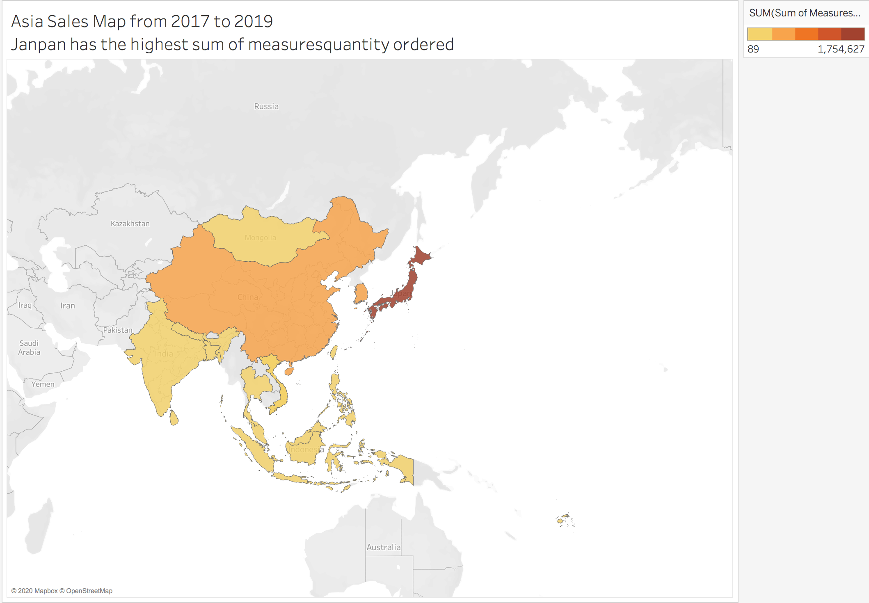
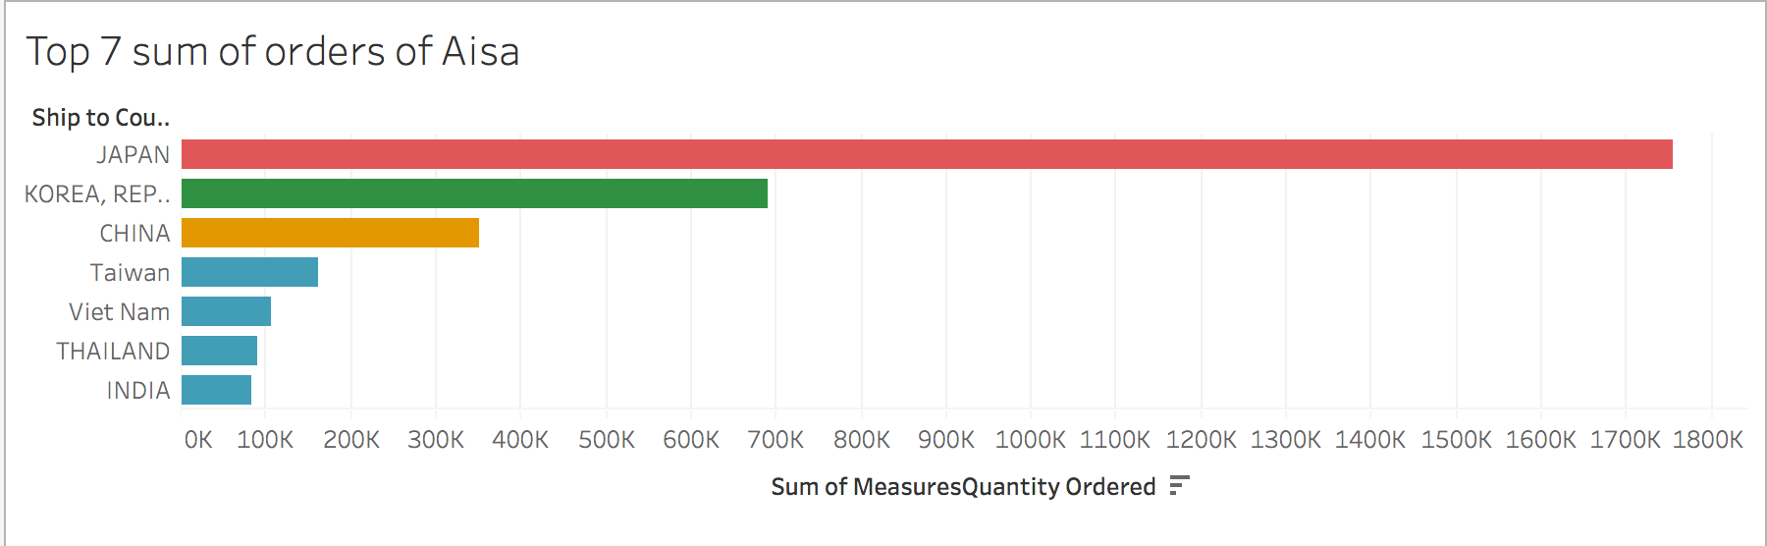
Asian Sales
Why we choose Asian Sales?
East Asia vs South Asia and Southeastern Asia
Advice: build a warehouse in Japan

Slide 9
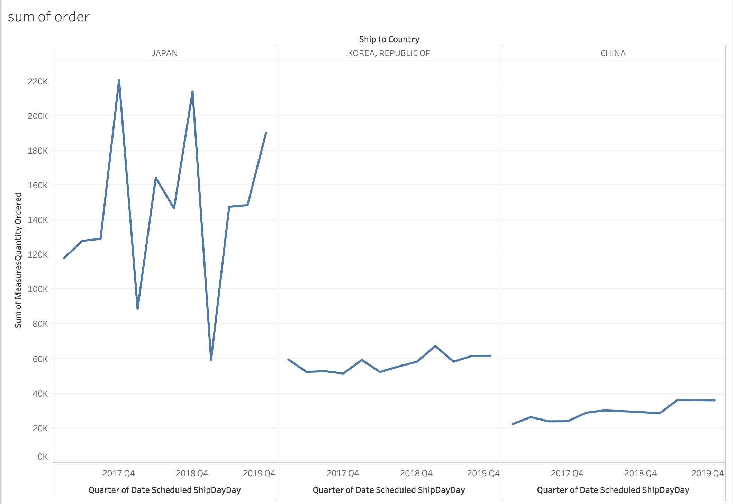
Asian Sales
Total order by quarter
Japan vs South Korea vs China
Advice: Preparing products in the third quarter

Slide 10
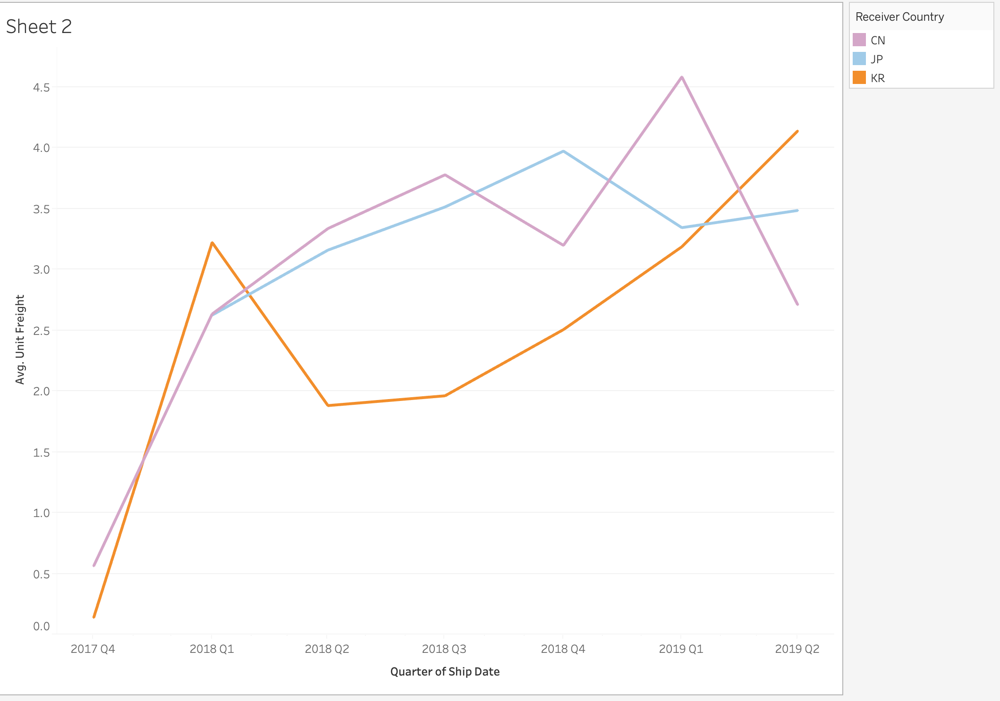
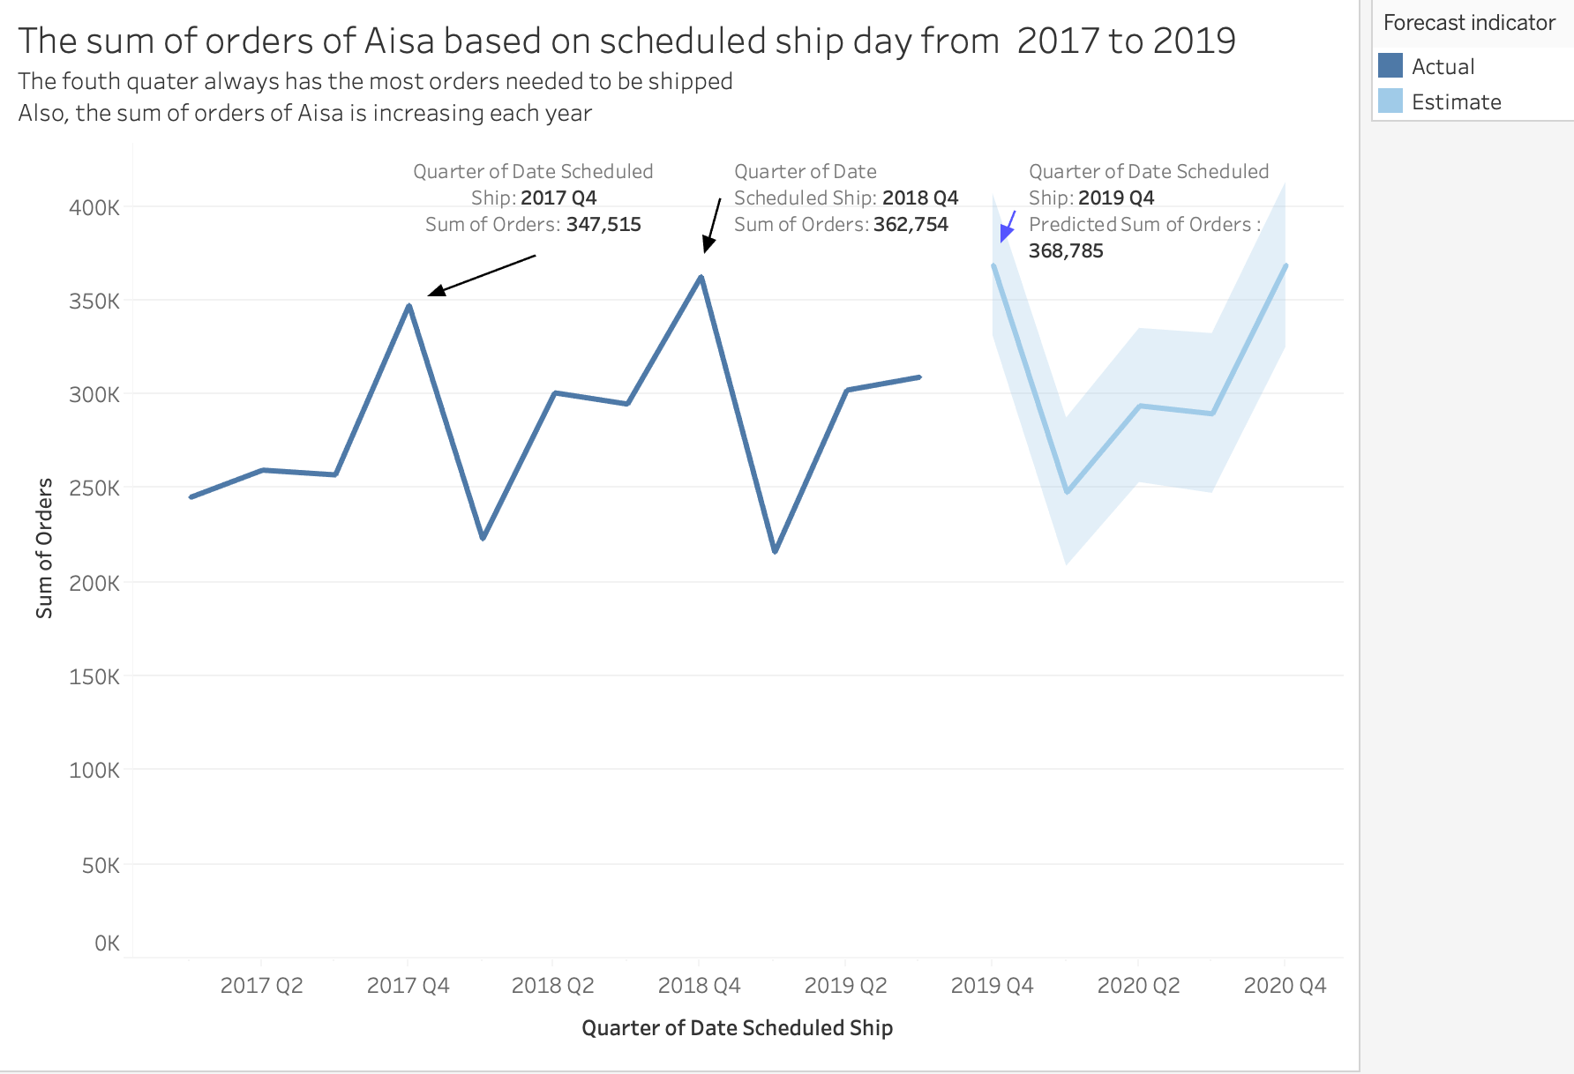
Asian Sales
Predict shipping dashboard
The cost of freight has changed dramatically. In Korea, the highest cost of freight per unit is in the first quarter while the highest price of shipping cost to Japan is in the fourth quarter.
According the 2017 and 2018 data to predict the number of medical devices that will be ordered by Asian Clients from ConMed in 2019

Slide 11
Asian Sales
Suggestions
The Shipping quantity in Japan which is the largest market in Asian since it is a reliable indicator that the number of goods sold in Asian will increase in 4th quarter.
There is a positive relationship between the price and quantity of shipping
We can ship and storage these high demand device in the lower price quarter in advance.

Slide 12
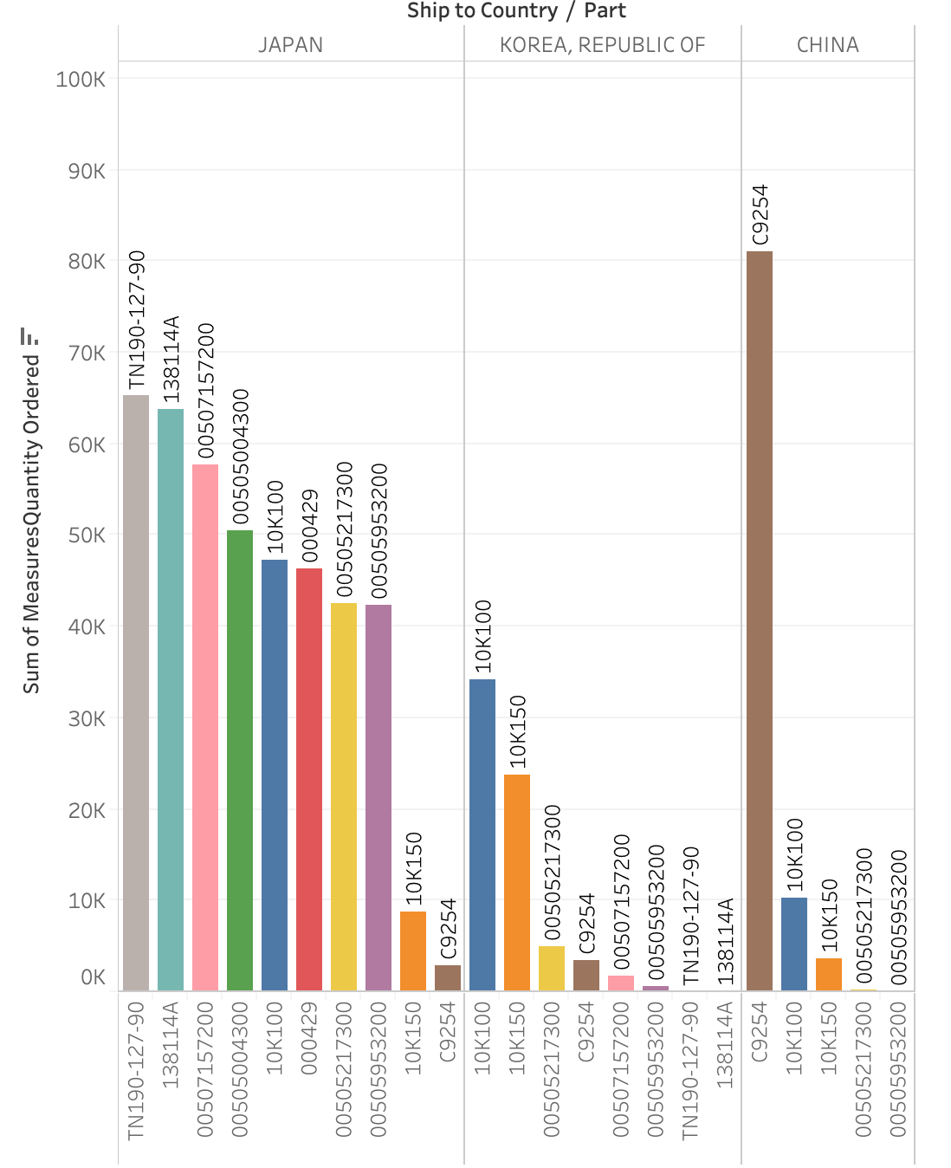
Asian Sales
Popular Medical device sold in Asian
We select the 3 Asia countries that purchase the most medical devices form ConMed.
Japan had ordered the largest number of medical devices, followed by Korea and China.
Japan ordered the wider variety type of goods with balanced distribution between regions compared to China where the most popular device was C9254 with more than 80,000 orders

Slide 13
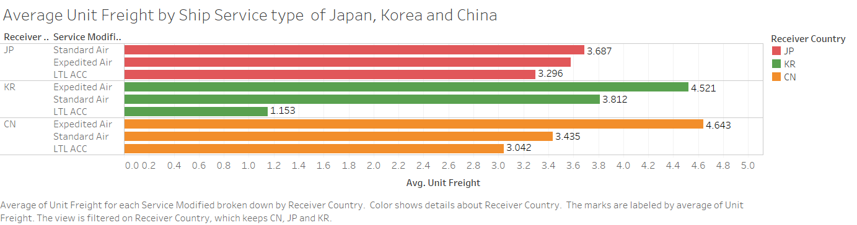
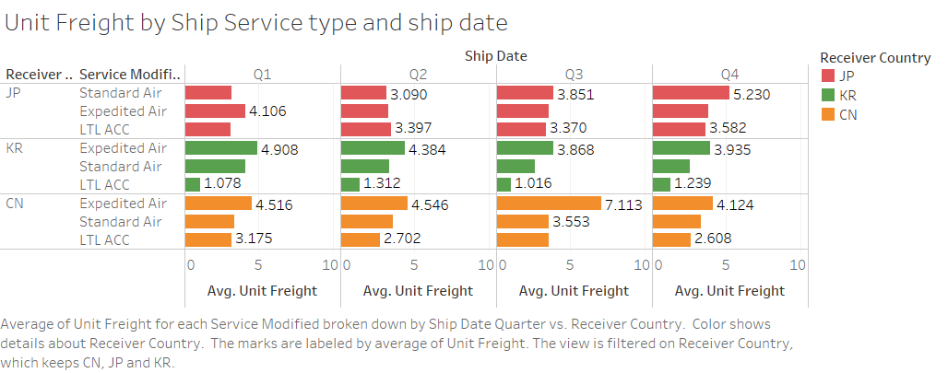
Asian Sales
Unit freight to Japan of Standard Air is the most expensive, but it is not far off from Expedited Air.
The price of standard air fee ship to Japan is influenced by season and waybill significantly.
The highest unit freight among these three countries is the expedited air to China and Korea.

Slide 14
Asian Sales
Suggestion:
Build a warehouse in Japan, and ship and store some of the most popular items ahead of the fourth quarter.

Slide 15
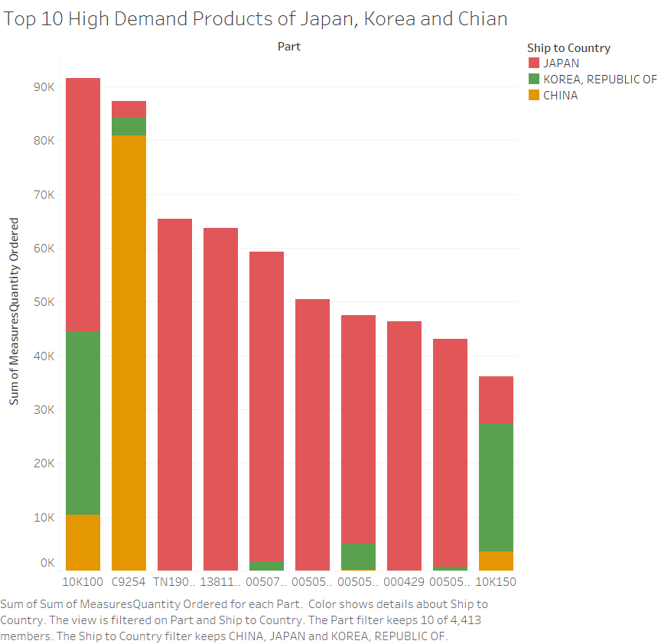
Asian Sales
In terms of top 10 high demand part in these three countries, 10K100 has the highest demand, which is 91,533 in total.
For C9254, the major demand of this product is from China, and the perennial demand of it is fairly average. Products like this can be shipped directly to the country of demand

Slide 16
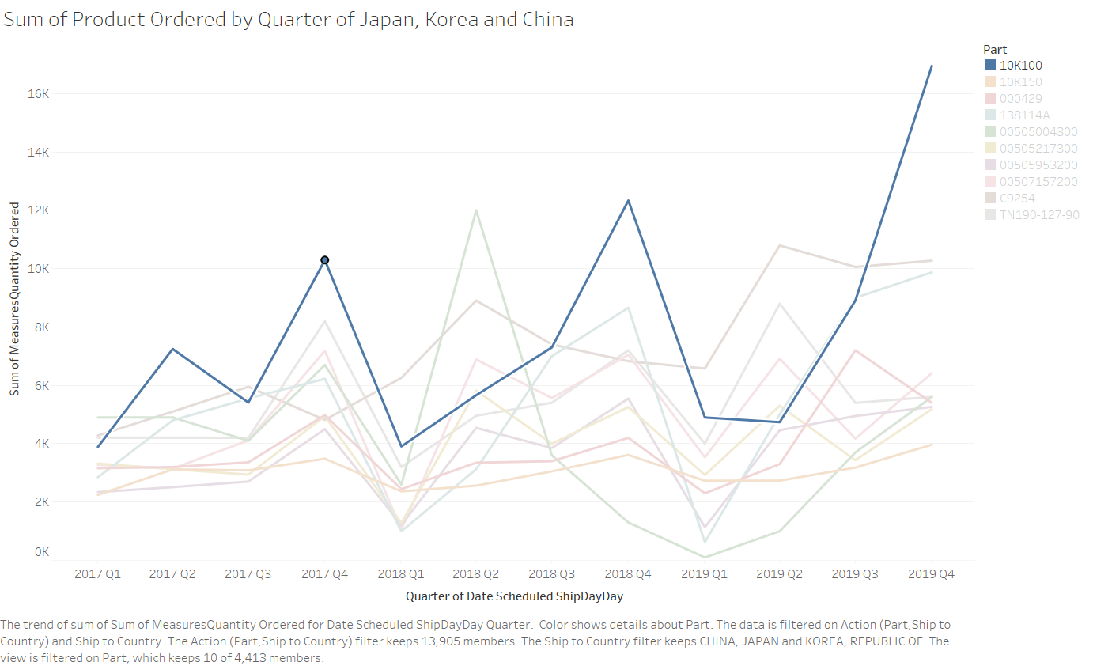
Asian Sales
In the fourth quarter, the demand of 10K100 is the highest.
At the same time, the freight also is the highest.
Suggestion:
Using standard air or ocean shipping and storing the minimum requirement of 10K100 in the warehouse all year round
Shipping more amount of 10K100 in the second quarter or the third quarter.

Slide 17
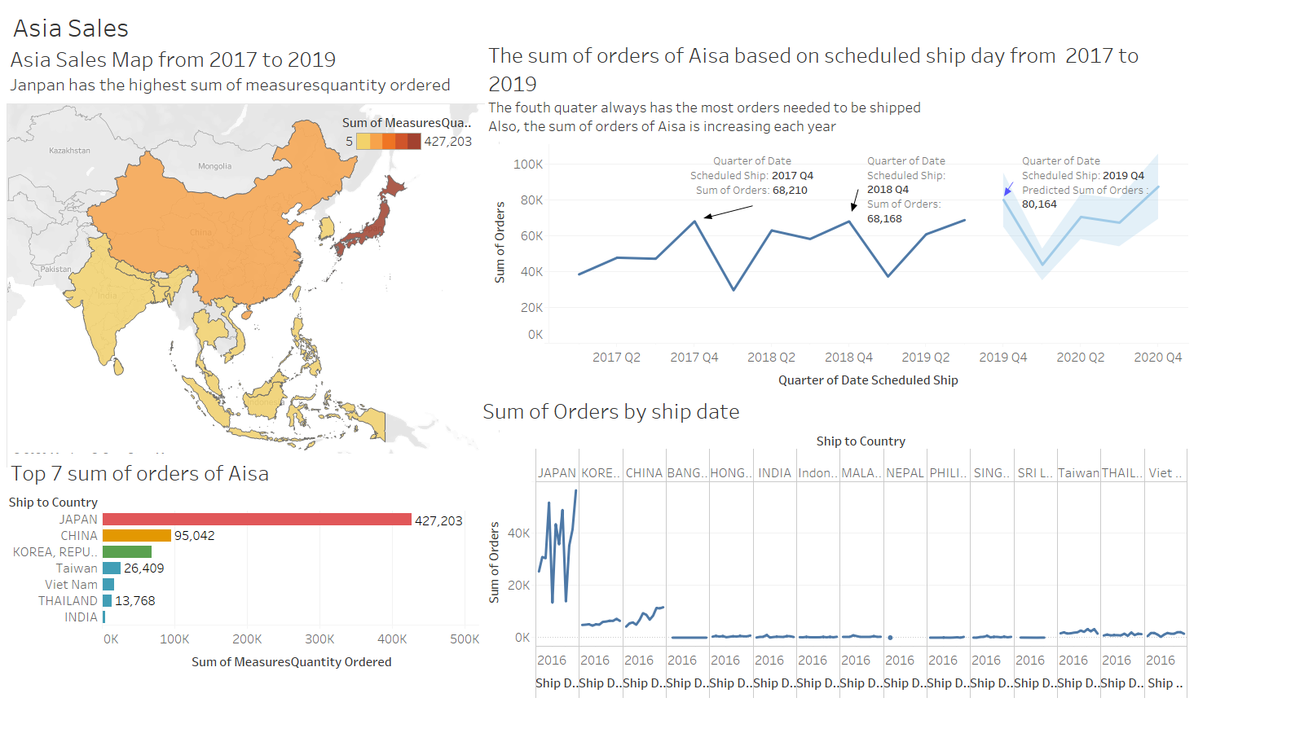
Asian Sales

Slide 18
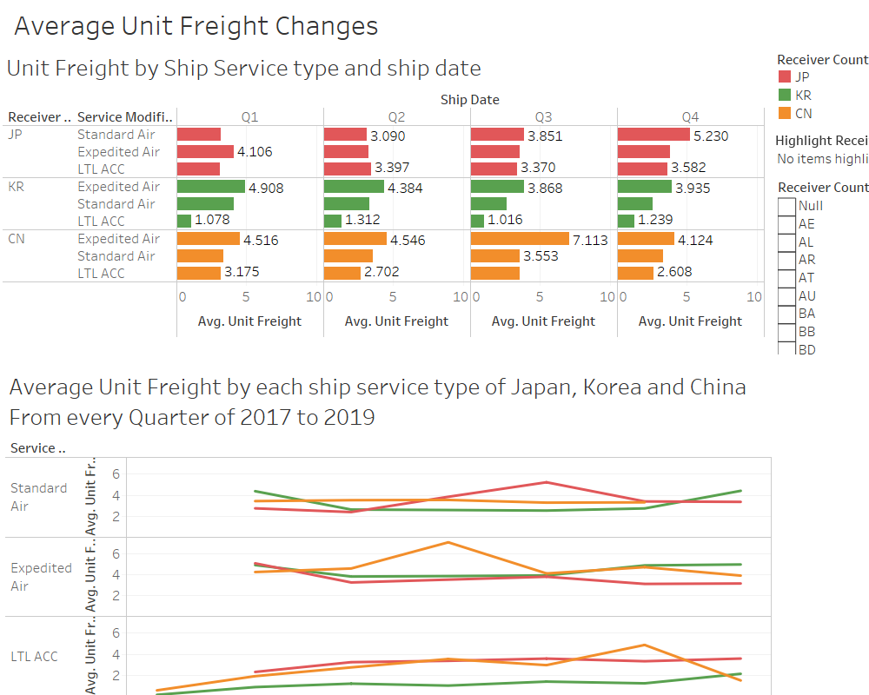
Asian Sales

Slide 19
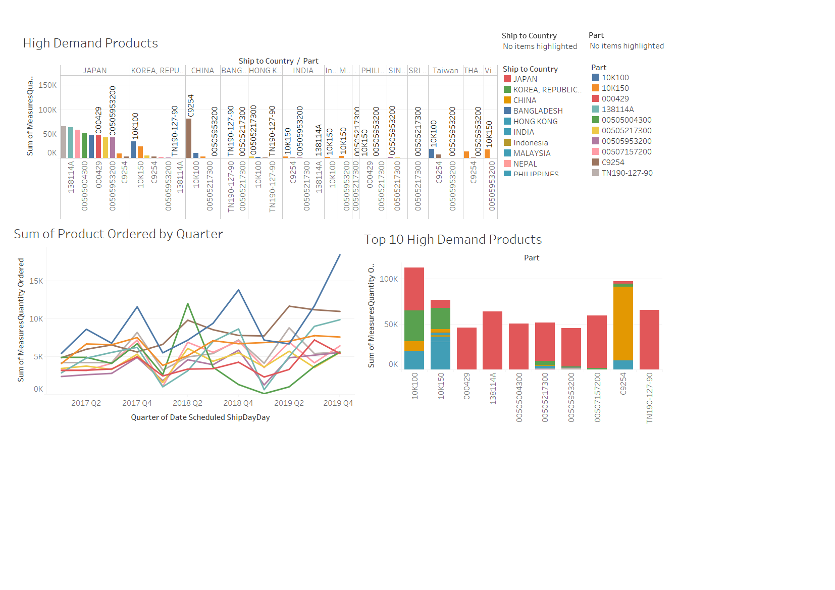
Asian Sales
This dashboard can give some instructions to ConMed to decide which product to ship to Japan warehouse and how far in advance to ship it.
For instance, you can choose 10K100 which has the highest demand among Asia, then you can get its orders vary according to the season and the country in which need to ship.

Slide 20
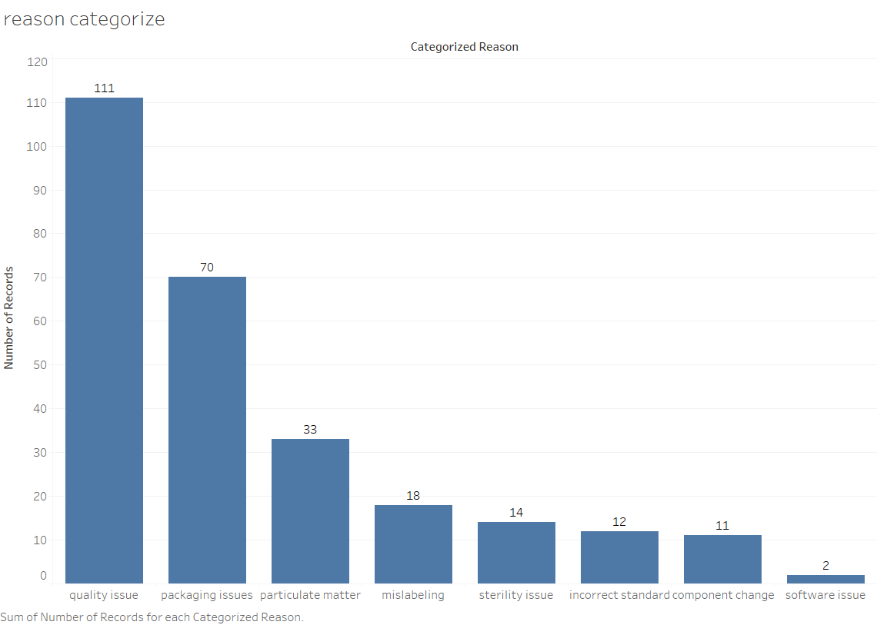
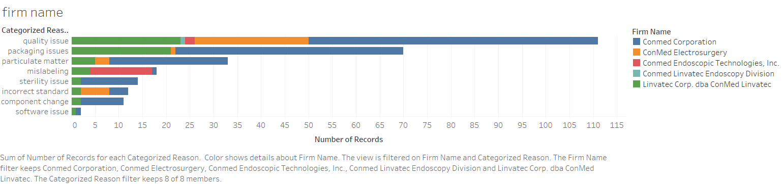
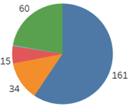
Recall
121 recalls belong to packaging issues, mislabeling and assembling issues, takes account of 44%
Conmed Corp contributed for the most packaging issues recalls, which takes account of 69%. And Conmed Endoscopic Technology had the most mislabeling recalls, which takes account of 72%.

Slide 21
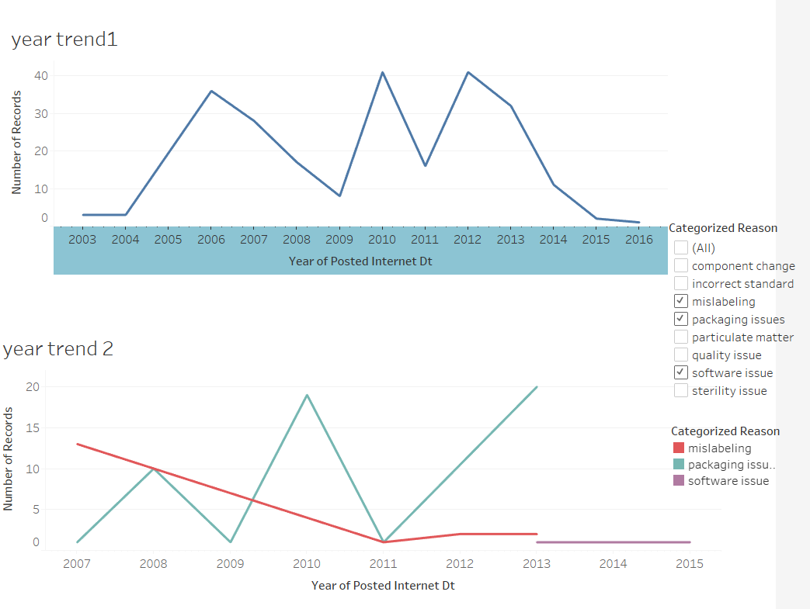
Recall
General trend fluctuates greatly.
Packaging trend goes upward while mislabeling has an obvious decline trend.
Software issue occurred in Conmed since 2013.

Slide 22

Conclusion
It can be inferred that for inbound packages if they are not time sensitive, Ocean is the service level that is most cost effective
Build a warehouse in Japan to reduce peak shipping costs and avoid direct high freight to other Asian countries.
Optimize the inventory of goods, improve the warehouse operation capacity and efficiency.
Improve sterile packaging technology and execution regulations to reduce packaging recall rates, set up a monitor and protection system to prevent software recalls in advance.

Slide 23
THANK YOU FOR YOUR WATCHING

